Slide 1
SEARCHINEERING
VISION: TO BECOME A PREFERRED STAFFING COMPANY
MISSION: TO PROVIDE CLEAR HIRING WITH INTEGRITY

Slide 2
ABOUT US
Searchineering is a specialised technical recruitment solutions provider for Oil & Gas ,EPC, Construction, MEP ,Power sectors .Founded in 2010 by a team of Engineering professionals with experience in EPC projects & Staffing services .
Searchineering serves the Indian & overseas clients by providing professional staffing services. Some of specific sectors are Oil & Gas industries, EPC, Construction/MEP , Hospitality & Healthcare, IT to name some & specific regions we serve are Middle East, Indian Sub-Continent & South East Asia.

Slide 3
WHAT WE DO
We recruit & outsource diversified Techno Commercial Managers, Engineers, and Professionals, Technicians for the Engineering Construction, & Oil and Gas Industries in India, Singapore, UAE, Kuwait, Qatar and KSA.
Our focus is on providing the best available engineering professionals to the industry as per client requirement without any cost & time overruns. Our service is client specific & is customized according to client requirements.
We are driven by customer-oriented service based on professional ethics. Our approach to recruitment of candidates is an efficient, focused, and professional. We offer careers to our customers cutting across cultures, countries.

Slide 4
WHERE WE OPERATE
We have Pan Indian network, such as Chennai, Hyderabad, Bangalore, Cochin, Delhi, Mumbai, Jaipur and Kolkata to execute the recruitment project successfully

Slide 5
OURSERVICES
Permanent Staffing
Contract Staffing
Head Hunting
Manpower Supply

Slide 6
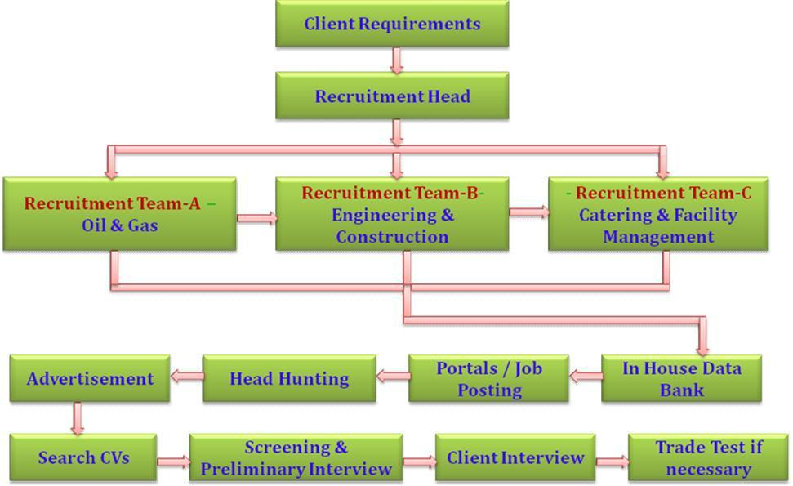
RECRUITMENT PROCEDURE

Slide 7
CATEGORIES RECRUITED
AUTOMOBILE INDUSTRY
WORK SHOP MANAGER WORK
SHOP SUPERVISOR HEAVY
EQUIPMENT MECHANIC
HYDRALIC MECHANIC
DIESEL MECHANIC (HEAVY / LIGHT)
AUTO ELECTRICIAN
HEAVY EQUIPMENT OPERATOR (JCB, LOADER, DOZER)
TOWER CRANE OPERATOR (MOBILE / CRAWLER)
DRIVER – HEAVY / TRUCK / TRAILER / LIGHT
DENTER
SPRAY PAINTER
TYREMAN

Slide 8
CONSTRUCTION & BUILDING INDUSTRIES
BRICK LAYER
MASONS-BRICK TILES
SHUTTERING CARPENTERS
STEEL FIXERS
PAINTERS
PLUMBERS
ELECTRICIAN
DRIVERS (TRAILER, HEAVY & LIGHT)
DUCT MEN – FITTER/FABRICATOR /INSULATOR
PIPE FABRICATORS
ALUMINUM OR GLASS FABRICATOR
SCAFFOLDERS
STEEL FABRICATORS
SUPERVISORS
WELDERS (TACK-3/4/6G)
WELDERS (TIG & MIG)
GYPSUM CARPENTERS AND BOARD FIXERS
AIR CONDITIONER TECHNICIAN CONSTRUCTION OR GENERAL HELPERS

Slide 9
ENGINEERING & PROJECTS (EPC)
ENGINEERING MANAGERS
PROPOSAL MANAGERS
LEAD ENGINEERS -PIPING & STRUCTURAL, EQUIPMENTS, PROCESS PROCESS DESIGN ENGINEERS
STATIC EQUIPMENT ENGINEERS & ROTATING EQUIPMENT ENGINEERS ELECTRICAL & INSTRUMENT ENGINEERS INSTRUMENT DESIGN ENGINEERS PIPING & STRUCTURAL ENGINEERS, DESIGNERS, D’MEN
PROJECT MANAGERS, ENGINEERS
ELECTRICAL ENGINEERS -T&D, SUBSTATION, OH LINES
PLANNING ENGINEERS
COSTING ENGINEERS
QC ENGINEERS & INSPECTORS
HSE ENGINEERS

Slide 10
HOTEL CREW & FACILITY MANAGEMENT
WAITER/WAITRESS
BELL BOY
CHEF
CLEANERS
EXECUTIVE HOUSE KEEPER
F&B MANAGER
GREEN KEEPER/MOWER
HAIR DRESSER
INTERPRETER
KITCHEN STAFF
LAUNDRY MAN
MAINTENANCE CREW
AIR CONDITION TECHNICIAN
UTILITY WORKER
JANITORS

Slide 11
INSPECTION
ELECTRICAL & INSTRUMENTATION INSPECTORS / QC ENGINEERS, CIVIL QC INSPECTOR,
ROTATING EQUIPMENT INSPECTORS / QC ENGINEERS, STATIC EQUIPMENT INSPECTORS / QC ENGINEERS, COATING INSPECTORS / QC ENGINEERS, WELDING INSPECTORS / QC ENGINEERS

Slide 12
OIL & GAS
MANAGERS & ENGINEERS (OFFSHORE/ONSHORE)
DRILLING ENGINEERS
WELL ENGINEERS
RIG MECHANICS RIG
ELECTRICIANS
ROUSTABOUT TOOL
PUSHERS FLOOR
MAN
SHUTDOWN CREWS
WELDER (GTAW, SMAW) – ALL POSITIONS
FABRICATOR (PIPE / STRUCTURAL / VESSEL / STORAGE TANKS)
FITTER (PIPE / STRUCTURAL / MILLWRIGHT)
MECHANICAL TECHNICIANS (ROTARY / STATIC) E & I TECHNICIAN

Slide 13
OUR CLIENT LIST
MANPOWER SUPPLY CONTRACT UNDER SEARCH INTERNATIONAL FZE
BAGHDAD COMPANY FOR GAS TURBINES LTD | - | IRAQ
CHEMIE-TECH | - | UAE
RAFIDAIN OIL SERVICES CO. | - | IRAQ
NDT INTERNATIONAL FZC | - | UAE
FUTURE OIL & GAS SERVICES (L.L.C) | - | UAE
AL NAHIYA GROUP | - | UAE

Slide 14
GLOBAL PETROLEUM | - | UAE
SAA TECHNICAL SERVICES EST | - | UAE
VELOSI | - | QATAR
RAMBOLL OIL & GAS QATAR | - | QATAR
ABRAJ ENERGY SERVICES | - | OMAN
SHALEEM PETROLEUM | - | OMAN
SINO GULF ENERGY GROUP | - | OMAN
CACTUS PREMIER DRILLING SERVICES SAOC | - | OMAN
PETRON GULF LLC | - | OMAN
AL ANSARI GROUP | - | OMAN
JAL INTERNATIONAL | - | KSA
TANMIA FOR OIL & CONSTRUCTION LTD | - | KSA

Slide 15
SEARCHINEERING
For Clients
E Mail: admin@searchineering.com
For Candidates apply@searchineering.com
Mob: +91 9940816192
www.searchineering.com

